Slide 1


Hii, Iam Siddhika
Welcome to Power BI Series
Part -16

Slide 2

Today Content
Are you ready guys?
continuing with
CREATING A DATA MODEL
HIERARCHIES
DATA MODEL BEST PRACTICES IMPORTANT QUESTIONS
FOR INTERVIEW

Slide 3

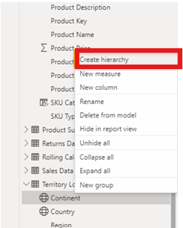
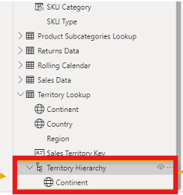
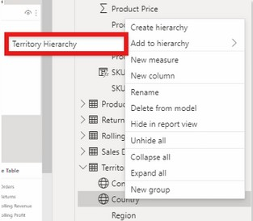
HIERARCHIES
Hierarchies are groups of columns that reflect multiple levels of granularity
For example, a Geography hierarchy might include Country, State and City fields
Hierarchies are treated as a single item in tables and reports, allowing users to “drill up” and “drill down” through each level
Have you got it?
Right-click another field (like “Country”) and select Add to Hierarchy (or drag it in!)
This hierarchy contains “Continent”, and is named “Territory Hierarchy”
In the Data pane, right-click a field and select Create hierarchy

Slide 4


DATA MODEL BEST PRACTICES
Remember
Start with a Clear Structure: Build your model with organized tables and relationships right from the beginning.
Keep it Simple: Make sure each table has a specific purpose, and use straightforward relationships.
Visualize Relationships: Arrange tables visually so it's clear how filters flow from one table to another.
Simplify Complexity: Avoid overly complicated relationships unless absolutely necessary.
Focus on Essential Data: Hide unnecessary fields from the report view to keep things clean and prevent confusion for users.
this

Slide 5

IMPORTANT QUESTIONS FOR INTERVIEW
What is the importance of data modeling in Power BI?
Can you explain the difference between fact and dimension tables?
How do you create relationships between tables in Power BI?
What are bi-directional filters, and when should they be used?
Why is it important to hide fields in the report view?
What are some best practices for organizing tables in a data model?
Can you describe the concept of normalization in data modeling?
What is the purpose of creating hierarchies in a data model?
How do you ensure data integrity when designing a data model?
Why is it recommended to avoid complex relationships in a data model?
Check these

Slide 6

Thank you for joining me today to learn about Part -16 of Power BI!
Remember, mastering data modeling is key to unlocking the full potential of Power BI for insightful reporting and visualization.
Stay tuned for more insights and tips on Power BI in our next Series.
Follow
Siddhika Shah

